Slide 1
Chapter 4
Operations
on
Bits

Slide 2
OBJECTIVES
After reading this chapter, the reader should
be able to:
Apply arithmetic operations on bits when the integer is
represented in two’s complement.
Apply logical operations on bits.
Understand the applications of logical operations using
masks.
Understand the shift operations on numbers and how a
Number can be multiplied or divided by powers of two
using shift operations.

Slide 3
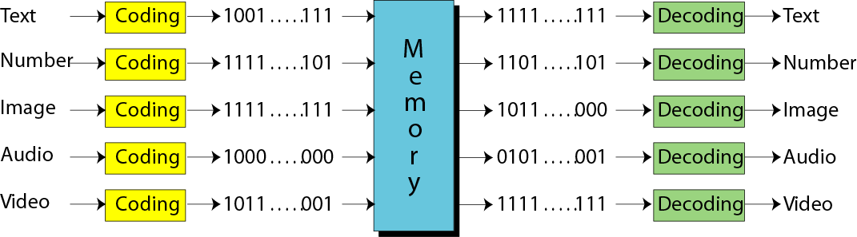
Thinking computer as
Programmable Data Processor Model
Program
Input Data
Computer HW
(Von Neumann Model)
Output Data
Data Type
Program
Storing different types of data as
universal format ---Bit Pattern
Operations on bits
Input Data
Output Data
bit pattern

Slide 4
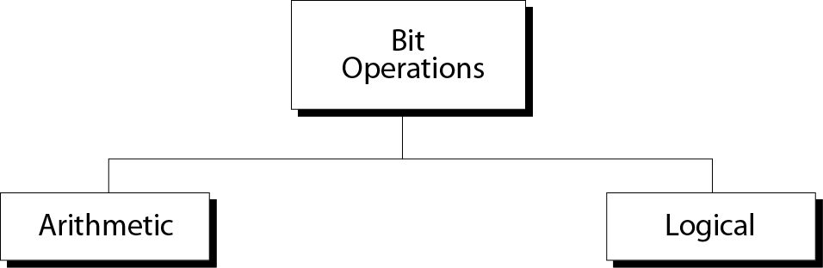
Figure 4-1
Operations on bits

Slide 5
Contents
4.1 Arithmetic Operations
4.2 Logical Operations
4.3 Shift Operations

Slide 6
4.1
ARITHMETIC
OPERATIONS

Slide 7
4.1 Arithmetic Operations
Arithmetic operations involve adding, subtracting, multiplying, dividing.
The multiplication operation can be implemented in software using repeated addition or in hardware using other techniques.
The division operation can also be implemented in software using repeated subtraction or in hardware using other techniques.

Slide 8
Addition in two’s complement
Number of 1s
------------
None
One
Two
Three
Result
-----------
0
1
0
1
Carry
--------
1
1
Table 4.1 Adding bits

Slide 9

Note:
Rule of Adding Integers in
Two’s Complement
Add 2 bits and propagate the carry to the next column. If there is a final carry after the leftmost column addition, discard it.

Slide 10
Example 1
Add two numbers in two’s complement representation: (+17) + (+22) ➔ (+39)
Solution
Carry 1
0 0 0 1 0 0 0 1 +
0 0 0 1 0 1 1 0
----------------------------------
Result 0 0 1 0 0 1 1 1 ➔ 39

Slide 11
Example 2
Add two numbers in two’s complement representation: (+24) + (-17) ➔ (+7)
Solution
Carry 1 1 1 1 1
0 0 0 1 1 0 0 0 +
1 1 1 0 1 1 1 1
----------------------------------
Result 0 0 0 0 0 1 1 1 ➔ +7

Slide 12
Example 3
Add two numbers in two’s complement representation: (-35) + (+20) ➔ (-15)
Solution
Carry 1 1 1
1 1 0 1 1 1 0 1 +
0 0 0 1 0 1 0 0
----------------------------------
Result 1 1 1 1 0 0 0 1 ➔ -15

Slide 13
Example 4
Add two numbers in two’s complement representation: (+127) + (+3) ➔ (+130)
Solution
Carry 1 1 1 1 1 1 1
0 1 1 1 1 1 1 1 +
0 0 0 0 0 0 1 1
----------------------------------
Result 1 0 0 0 0 0 1 0 ➔ -126 (Error)
An overflow has occurred.

Slide 14
Overflow is an error that occurs when you try to store a number that is not within the range defined by the allocation.
Note:
Range of numbers in two’s complement
representation
- (2^{N-1}) ---------- 0 ----------- +(2^{N-1} –1)

Slide 15
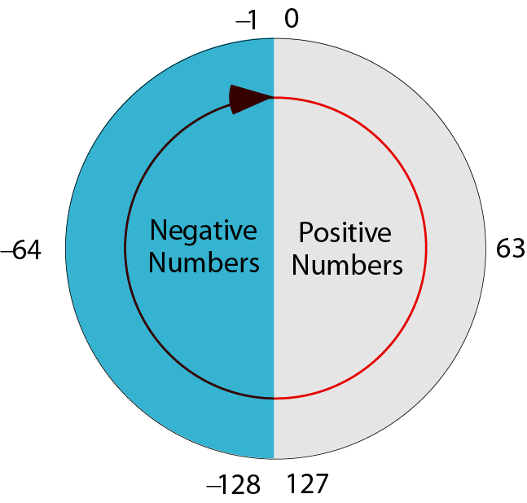
Figure 4-2
Two’s complement numbers visualization

Slide 16
Note:
When you do arithmetic operations on
numbers in a computer, remember that
each number and the result should be
in the range defined by the bit allocation.

Slide 17
Subtraction in two’s complement
Example 5
Subtract 62 from 101 in two’s complement:
(+101) - (+62) ⬅➔ (+101) + (-62)
Solution
Carry 1 1
0 1 1 0 0 1 0 1 +
1 1 0 0 0 0 1 0
----------------------------------
Result 0 0 1 0 0 1 1 1 ➔ 39
The leftmost carry is discarded.

Slide 18
Arithmetic operations on floating-point umbers
Example 6
Add two floats:
0 10000100 10110000000000000000000
0 10000010 01100000000000000000000
Solution
The exponents are 5 and 3. The numbers are:
+2⁵ x 1.1011 and +2³ x 1.011
Make the exponents the same.
(+2⁵ x 1.1011)+ (+2⁵ x 0.01011) ➔ +2⁵ x 10.00001
After normalization +2⁶ x 1.000001, which is stored as:
0 10000101 000001000000000000000000

Slide 19
4.2
LOGICAL
OPERATIONS

Slide 20
4.2 Logical operations
We can interpret 0 as the logical value false and 1 as the logical value true.
A logical operation can accept 1 or 2 bits to create only 1 bit. If the operation is applied to only one input, it is a unary operation(单目操作). If it is applied to 2 bits, it is a binary operation(双目操作).

Slide 21
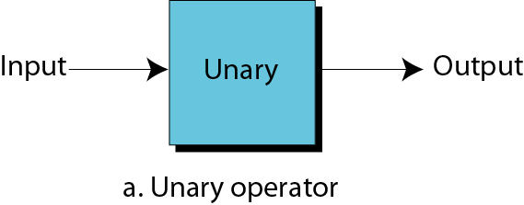
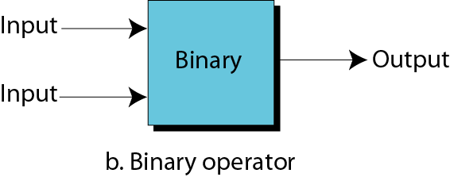
Figure 4-3
Unary and binary operations

Slide 22
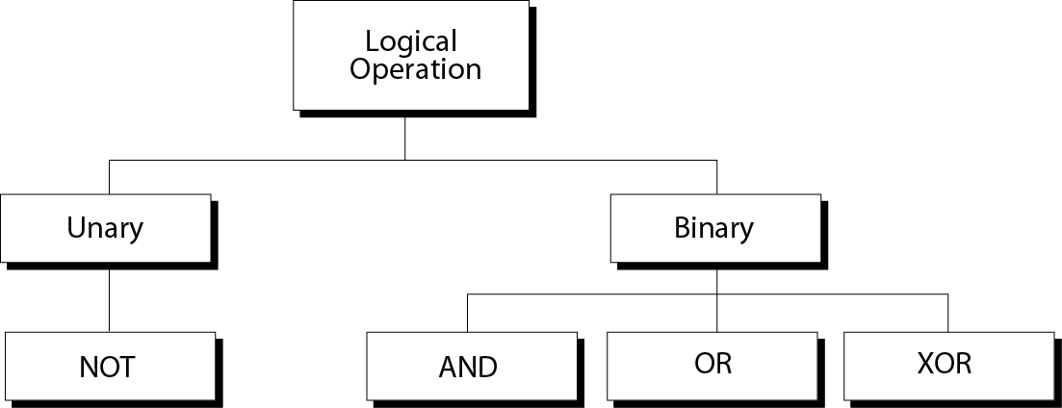
Figure 4-4
Logical operations

Slide 23
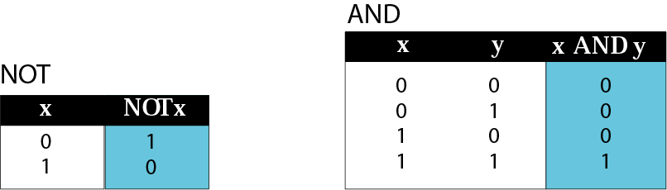
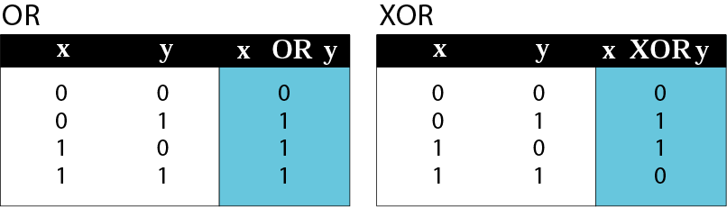
A truth table lists all the possible input combinations with the corresponding output.
Figure 4-5

Slide 24
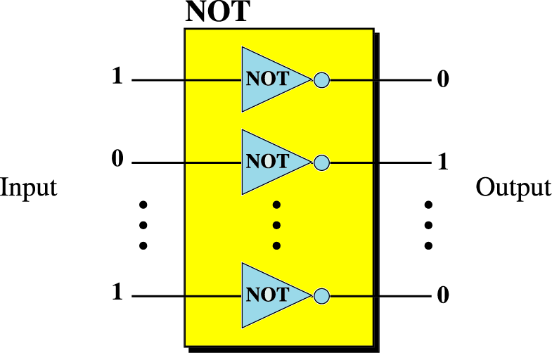
Figure 4-6
NOT operator
NOT=Reverse

Slide 25
Example 7
Use the NOT operator on the bit pattern 10011000
Solution
Target 1 0 0 1 1 0 0 0 NOT
------------------
Result 0 1 1 0 0 1 1 1

Slide 26
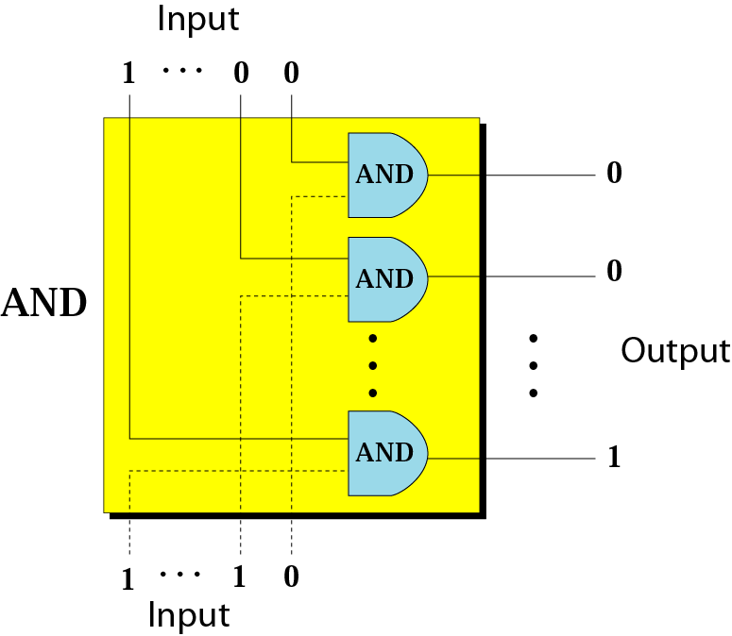
Figure 4-7
AND operator
AND=ALL

Slide 27
Example 8
Use the AND operator on bit patterns 10011000 and 00110101.
Solution
Target 1 0 0 1 1 0 0 0 AND
0 0 1 1 0 1 0 1
------------------
Result 0 0 0 1 0 0 0 0

Slide 28
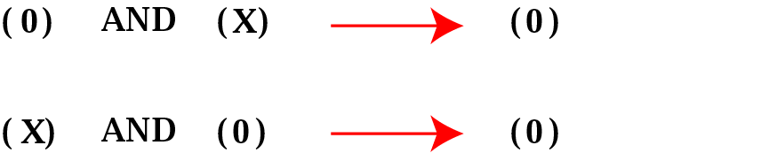
Figure 4-8
Inherent rule of the AND operator
(X) AND (0) → 0
(X) AND (1) → (X)

Slide 29
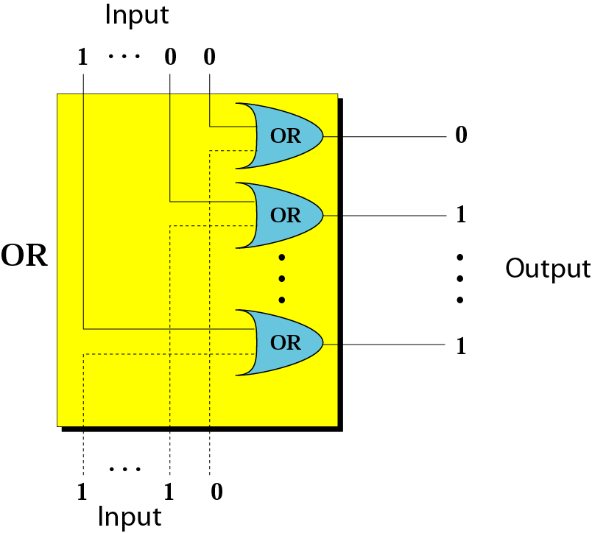
Figure 4-9
OR operator
OR=ANY

Slide 30
Example 9
Use the OR operator on bit patterns 10011000 and 00110101
Solution
Target 1 0 0 1 1 0 0 0 OR
0 0 1 1 0 1 0 1
------------------
Result 1 0 1 1 1 1 0 1

Slide 31
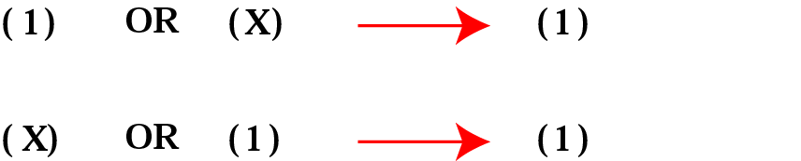
Figure 4-10
Inherent rule of the OR operator
(X) OR (0) → (X)
(X) OR (1) → 1

Slide 32
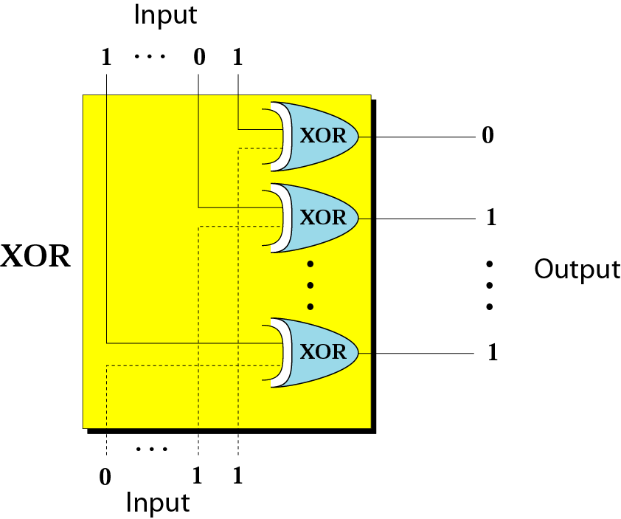
Figure 4-11
XOR operator
XOR=Differ

Slide 33
Example 10
Use the XOR operator on bit patterns 10011000 and 00110101.
Solution
Target 1 0 0 1 1 0 0 0 XOR
0 0 1 1 0 1 0 1
------------------
Result 1 0 1 0 1 1 0 1

Slide 34
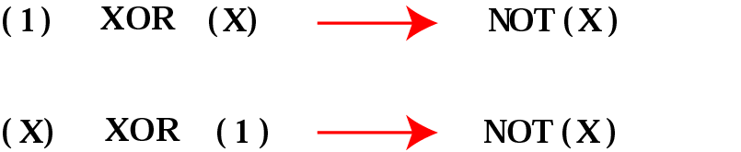
Figure 4-12
Inherent rule of the XOR operator
(X) XOR (0) → (X)
(X) XOR (1) → NOT(X)

Slide 35
Applications
The three logical binary operations can be used to modify a bit pattern.
They can unset, set, or reverse specific bits.
The bit pattern to be modified is ANDed, ORed, or XORed with a second bit pattern, which is called the mask.

Slide 36
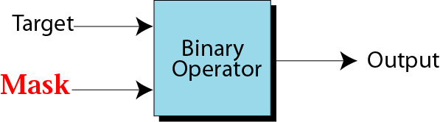
Applications
Mask
Figure 4-13

Slide 37
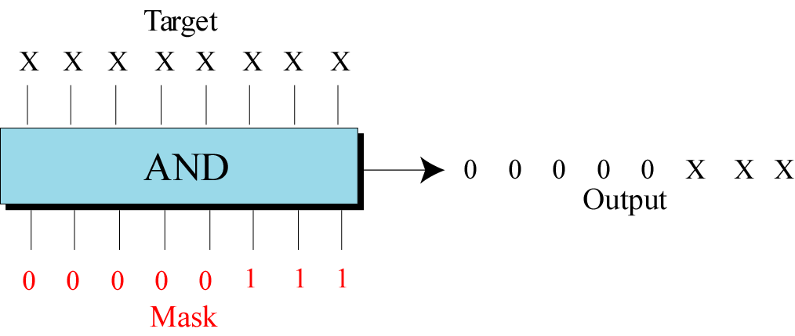
Figure 4-14
Example of unsetting specific bits

Slide 38
Example 11
Use a mask to unset (clear) the 5 leftmost bits of a pattern. Test the mask with the pattern 10100110.
Solution
The mask is 00000111.
Target 1 0 1 0 0 1 1 0 AND
Mask 0 0 0 0 0 1 1 1
------------------
Result 0 0 0 0 0 1 1 0

Slide 39
Example 12
Imagine a power plant that pumps water to a city using eight pumps. The state of the pumps (on or off) can be represented by an 8-bit pattern. For example, the pattern 11000111 shows that pumps 1 to 3 (from the right), 7 and 8 are on while pumps 4, 5, and 6 are off. Now assume pump 7 shuts down. How can a mask show this situation?
Solution on the next slide.

Slide 40
Solution
Use the mask 10111111 to AND with the target pattern. The only 0 bit (bit 7) in the mask turns off the seventh bit in the target.
Target 1 1 0 0 0 1 1 1 AND
Mask 1 0 1 1 1 1 1 1
------------------
Result 1 0 0 0 0 1 1 1

Slide 41
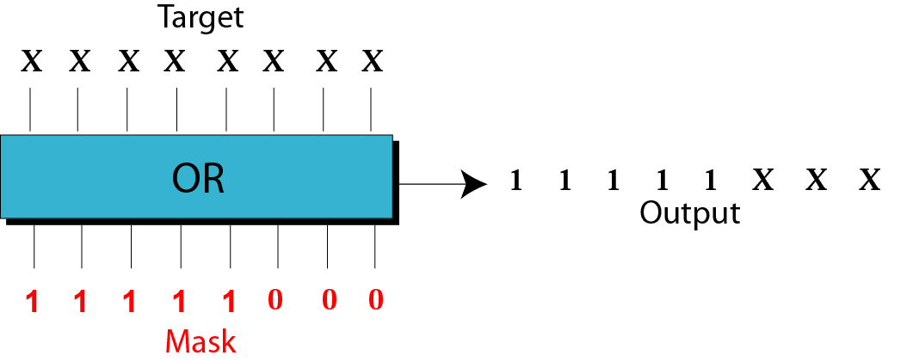
Figure 4-15
Example of setting specific bits

Slide 42
Example 13
Use a mask to set the 5 leftmost bits of a pattern. Test the mask with the pattern 10100110.
Solution
The mask is 11111000.
Target 1 0 1 0 0 1 1 0 OR
Mask 1 1 1 1 1 0 0 0
------------------
Result 1 1 1 1 1 1 1 0

Slide 43
Example 14
Using the power plant example, how can you use a mask to to show that pump 6 is now turned on?
Solution
Use the mask 00100000.
Target 1 0 0 0 0 1 1 1 OR
Mask 0 0 1 0 0 0 0 0
------------------
Result 1 0 1 0 0 1 1 1

Slide 44
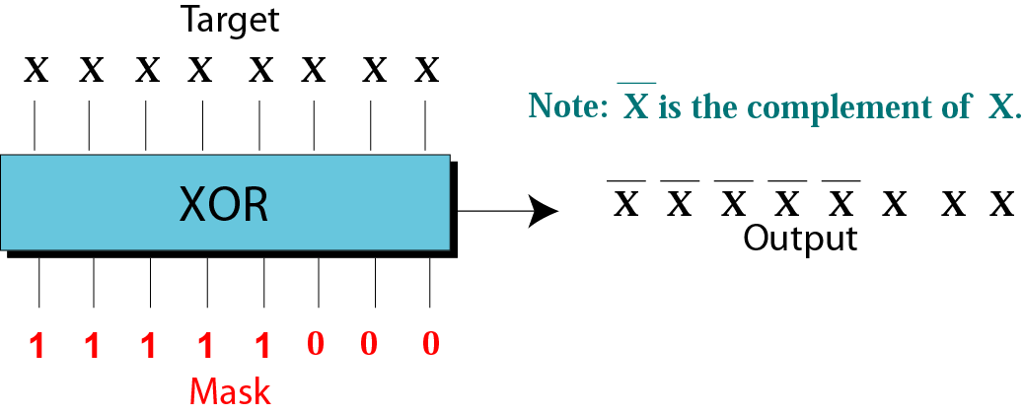
Figure 4-16
Example of flipping specific bits

Slide 45
Example 15
Use a mask to flip the 5 leftmost bits of a pattern. Test the mask with the pattern 10100110.
Solution
Target 1 0 1 0 0 1 1 0 XOR
Mask 1 1 1 1 1 0 0 0
------------------
Result 0 1 0 1 1 1 1 0

Slide 46
4.3
SHIFT
OPERATIONS

Slide 47
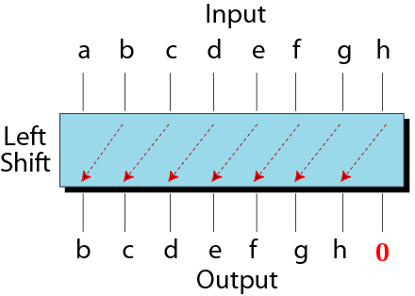
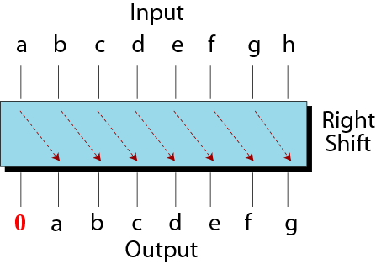
Figure 4-17
Shift operations

Slide 48
Example 16
Show how you can divide or multiply a number by
2 using shift operations.
Solution
An unsigned number: a right-shift operation divides the number by two. The pattern 00111011 represents 59. When you shift the number to the right, you get 00011101, which is 29. If you shift the original number to the left, you get 01110110, which is 118.

Slide 49
Example 17
Use a combination of logical and shift operations to find the value (0 or 1) of the fourth bit (from the right).
Solution
Use the mask 00001000 to AND with the target to keep the fourth bit and clear the rest of the bits.
Continued on the next slide

Slide 50
Solution (continued)
Target a b c d e f g h AND
Mask 0 0 0 0 1 0 0 0
------------------
Result 0 0 0 0 e 0 0 0
Shift the new pattern three times to the right
0000e000 ➔ 00000e00 ➔ 000000e0 ➔ 0000000e
Now it is easy to test the value of the new pattern as an unsigned integer. If the value is 1, the original bit was 1; otherwise the original bit was 0.

